Slide 1
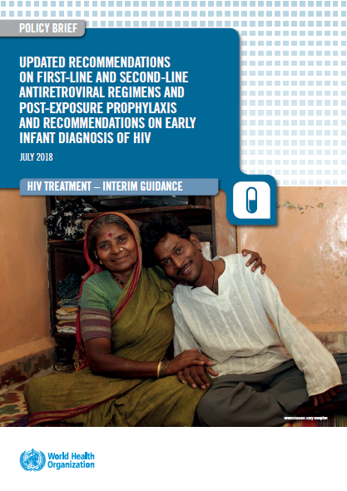
Country Experiences monitoring new ARVs: Introductory Remarks
Meg Doherty MD MPH PhD
27 July 2018 WHO HQ

Slide 2
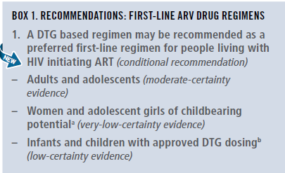
New recommendations first-line ARV regimens

Slide 3
Note of caution for using DTG in women and adolescent girls of childbearing potential
Exposure to DTG at the time of conception may be associated with NTD risk among infants.
DTG appears to be safe when started after the period of risk of neural tube defects (ie, up to 8 weeks after conception).
Adolescent girls and women of childbearing potential who do not currently want to become pregnant can receive DTG together with consistent contraception (hormonal contraception and DTG have no reported or expected drug–drug interactions).
An EFV-based regimen is a safe and effective first-line regimen and can be used among women of childbearing potential during the period of potential risk for developing NTDs.
National programmes should consider the balance of benefits and risks when selecting the optimal ARV regimen for women and adolescent girls of childbearing potential (fertility levels, contraceptive availability and coverage, pretreatment resistance to NNRTIs at the population level, drug availability and the maternal and infant toxicity profile).

Slide 4
WHO 2018 recommendations for first-line
Population | Preferred | Alternatives | Special situations
Adult men and adolescent boys | TLDª | TLE600 TLE400 | AZT+3TC+ EFV600^{b} TDF+3TC (or FTC)+PI/r^{c}
Pregnant (from eight weeks after conception) and breastfeeding women and adolescent girls
Women and adolescent girls with effective contraception or not of childbearing potential
Women and adolescent girls of childbearing potential who want to become pregnant and have no effective contraception | TLE600 | TLE400 TDF+3TC (or FTC)+PI/r^{c} | AZT+3TC+ EFV600^{b} TDF+3TC (or FTC)+ RAL
In PLHIV with TB using rifampicin, the dose of DTG needs to be increased to 50 mg twice daily.
NVP may be used in special circumstances where alternative options are not available.
If national prevalence of EFV pretreatment drug resistance exceeds 10% or if no other alternatives are available.
TLD = TDF + 3TC + DTG
TLE = TDF + 3TC (or FTC) + EFV
Notes:
TDF & XTC are currently recommended as the preferred NRTI backbone for ART initiation
Large clinical evidence and programmatic advantages support the use of DTG as preferred 1st line option for all adults and adolescents with HIV , including women and adolescents girls using consistent and reliable contraception.
Concerns regarding safety of DTG use during periconception period were recently identified, but are based on limited data and has been closely investigated by WHO and other partners.

Slide 5
Sequencing options for preferred first-, second- and third-line ART regimens in adults and adolescents (including pregnant women and women childbearing potential)
Population | 1st line regimens | 2nd line regimens | 3rd line regimens
Adults and adolescents (including pregnant and childbearing age women)ª | 2 NRTIs + DTG ^{b} | 2 NRTIs + (ATV/r or LPV/r) | DRV/r ^{e f} + DTG ^{g} ± 1-2 NRTIs (where possible consider optimization using genotyping)
 | 2 NRTIs + EFV | 2 NRTIs + DTG ^{b}
 | 2 NRTIs + LPV/r | 2 NRTIs + DTG ^{c}
 | 2 NRTIs + EFV | 2 NRTIs + DTG ^{d}
a Optimized NRTI backbone should be used: AZT following TDF or ABC failure, and vice-versa.
b In childbearing age women an adolescent girls, DTG can be used in those on reliable contraception and fully informed and benefit outweighs the risk.
c This applies to children for whom approved DTG dosing is available. RAL should remain the preferred 2nd line for those children for whom approved DTG is not available.
d ATV/r or LPV/r should remain the preferred 2nd line for those children for whom approved DTG is not available. This applies to children for whom approved DTG dosing is available.
e In PI-experienced patients, the recommended DRV/r dose should be 600mg/100 mg twice daily.
f DRV/r should not be used in children younger than three years of age.
g DTG based 3rd line following use of INSTI must be administered with DTG BD.

Slide 6
Types of Data available
Data from Pharmacovigilence databases
APR, ,EMA, FDA, WHO VigiBase, WHO/TDR Global repository PV data
Trial Data
Basic Science
Country policy & programmatic data
Retrospective Cohort
Prospective data from active surveillance

Slide 7
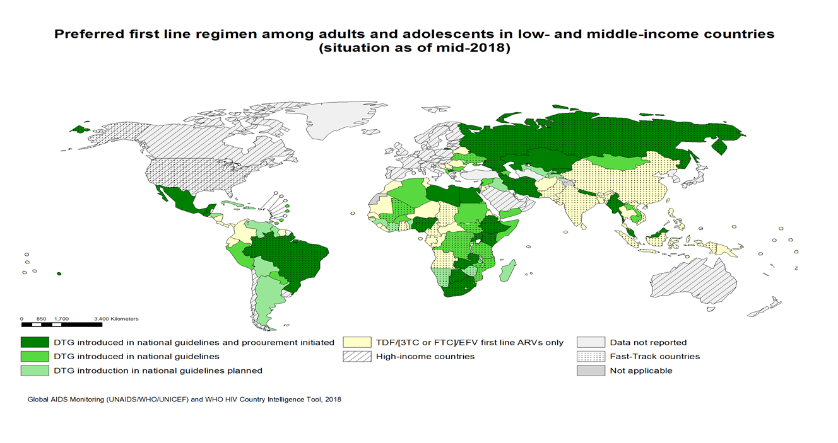
DTG uptake by countries
By July 2018, 71 LMICs (51%) informed that have included or are planning to include DTG in their national guidelines :
DTG introduced in national guidelines: 26
DTG introduced in national guidelines and procurement initiated: 24
DTG introduction in national guidelines planned : 21
Approximately 500 000 PLHIV are using DTG globally
* preliminary data

Slide 8
DTG transition as 1st line: plans and guidance revision
Information received from 56 Countries
DTG 1st line already rolled out
8 countries
GL revised
5 Countries
GL revision Planned
1 Country
Not DTG as 1st line
22 countries
DTG 1st line Planned
26 countries
No information on revision plan
2 Countries
GL revised
7 Countries
GL revision On-going/Planned
7 Countries
GL revision on hold
5 countries
No information on revision plans
7 Countries
GL: guidelines

Slide 9
Countries Guidance revision on DTG 1st line: WLHIV initiating DTF based regimen
Results from in country discussion on use DTG among Women Child Bearing age (WCAB) in countries that have already revised the GL and with on-going GL revision (17 countries)
WLHIV
WCBA*
PW
ANY contraception→ DTG
No contraception→ NO- DTG
Counselling on risk/benefit and on contraception
a) DTG
b) Preferred NO-DTG but informed choice allowed
All PW →
NO-DTG based regimen
PW identified within 8wk or 1st trim → NO-DTG
PW identified later (>2nd trim) → DTG based regimen
All WCBA
NO-DTG based regimen
Long term contraception→ DTG
No contraception→ NO- DTG
3 countries
13 countries
a) 1 country**
b) 1 country
2 countries**
6 Countries**
7 countries
Preferred NO-DTG based but informed choice allowed
1 country
*Several countries defined WCBA as women 10-49 years old or in pre-menopausal period
** 6 countries recommend Pregnancy test to be performed before starting WCBA on DTG based regimen

Slide 10
Timeline to review future data 2018-2019
2018
April
May
June
July
August
September
October
November
December
2019
January
February
March
April
May
18 May WHO DTG safety alert
AIDS 2018
Discussion s
Systematic reviews; review of data with FDA, EMA, APR, ViiV
Global & country discussions, IAS/WHO Meeting
Iterative review by WHO technical and Safety Groups, ASCoMP and partners
GDG Meeting 16-18 May
GDG Meeting TBD
Webex to Countries and to partners
Re-review of guidance
Interim guidance

Slide 11
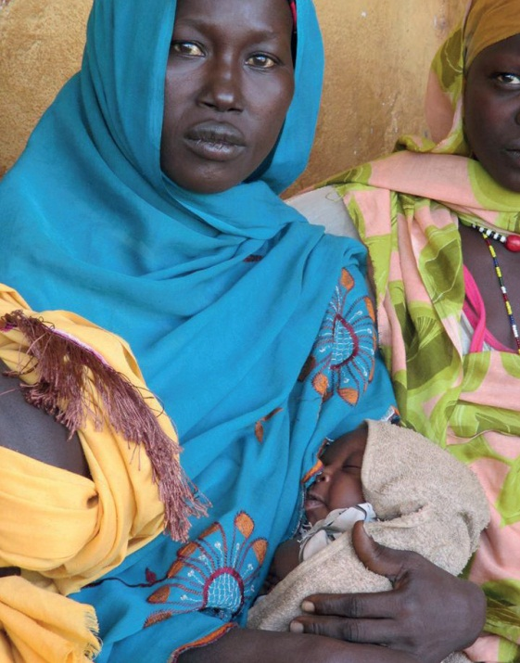
Acknowledgements
Guidelines Development Group members
Lynne Mofenson
Rebecca Zash
WHO Treatment and Care team
Marco Vitoria
Martina Penazzato
Serena Brusamento
Chantal Migone
Nathan Ford
Lara Vojnov
Silvia Bertagnolio
Vindi Singh
Ajay Rangaraj
Anisa Ghadrshenasa
Systematic Review Teams
External Review Group
PEPFAR, Global Fund, Gates, CDC, USAID
ICW, GPN+, APN+, ITPC

